Slide 1
Meeting 13/12
Joren Janzing

Slide 2
Content
General
Different El Ninos, different effects on the winds…
Detecting ENSO events.

Slide 3
General
I have permission to go to Cambridge ☺
I do have access to the mail with MFA
I can’t open the link to change my UNIX password… (BAS IT Service0)
Meeting with instructions…
servicedesk@bas.

Slide 4
A Tale of Four El Niños: Different El Ninos, different effects on wind..

Slide 5
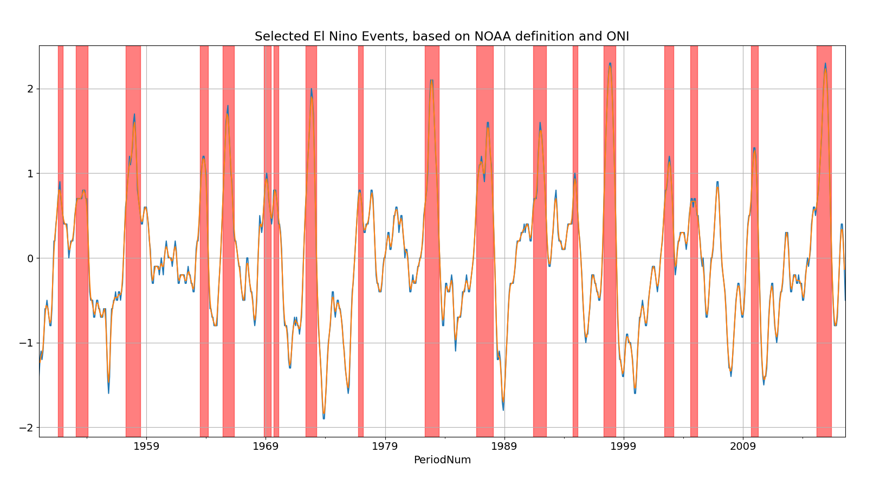

Slide 6
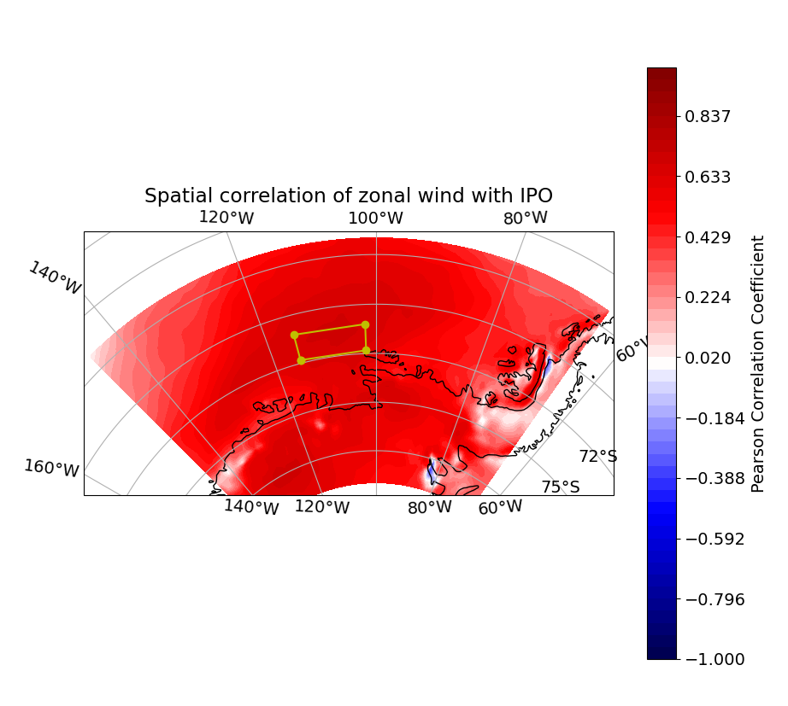

Slide 7
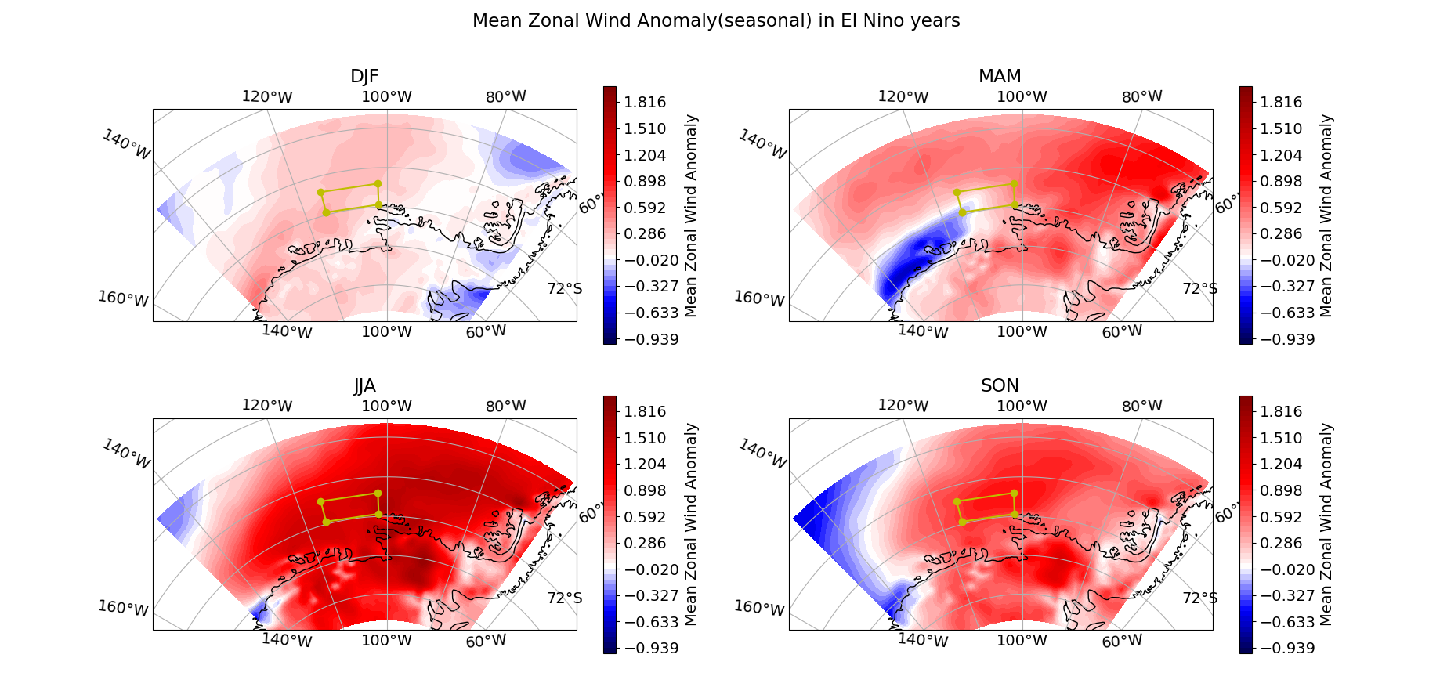
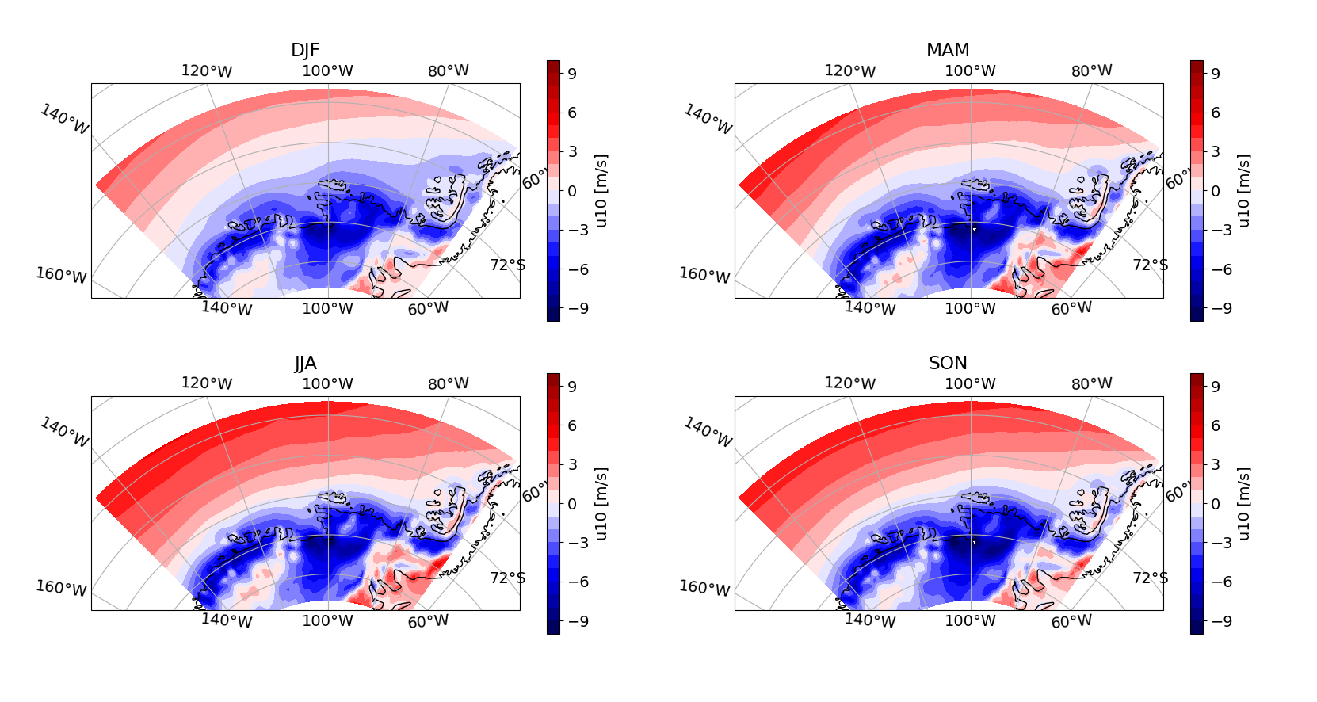

Slide 8
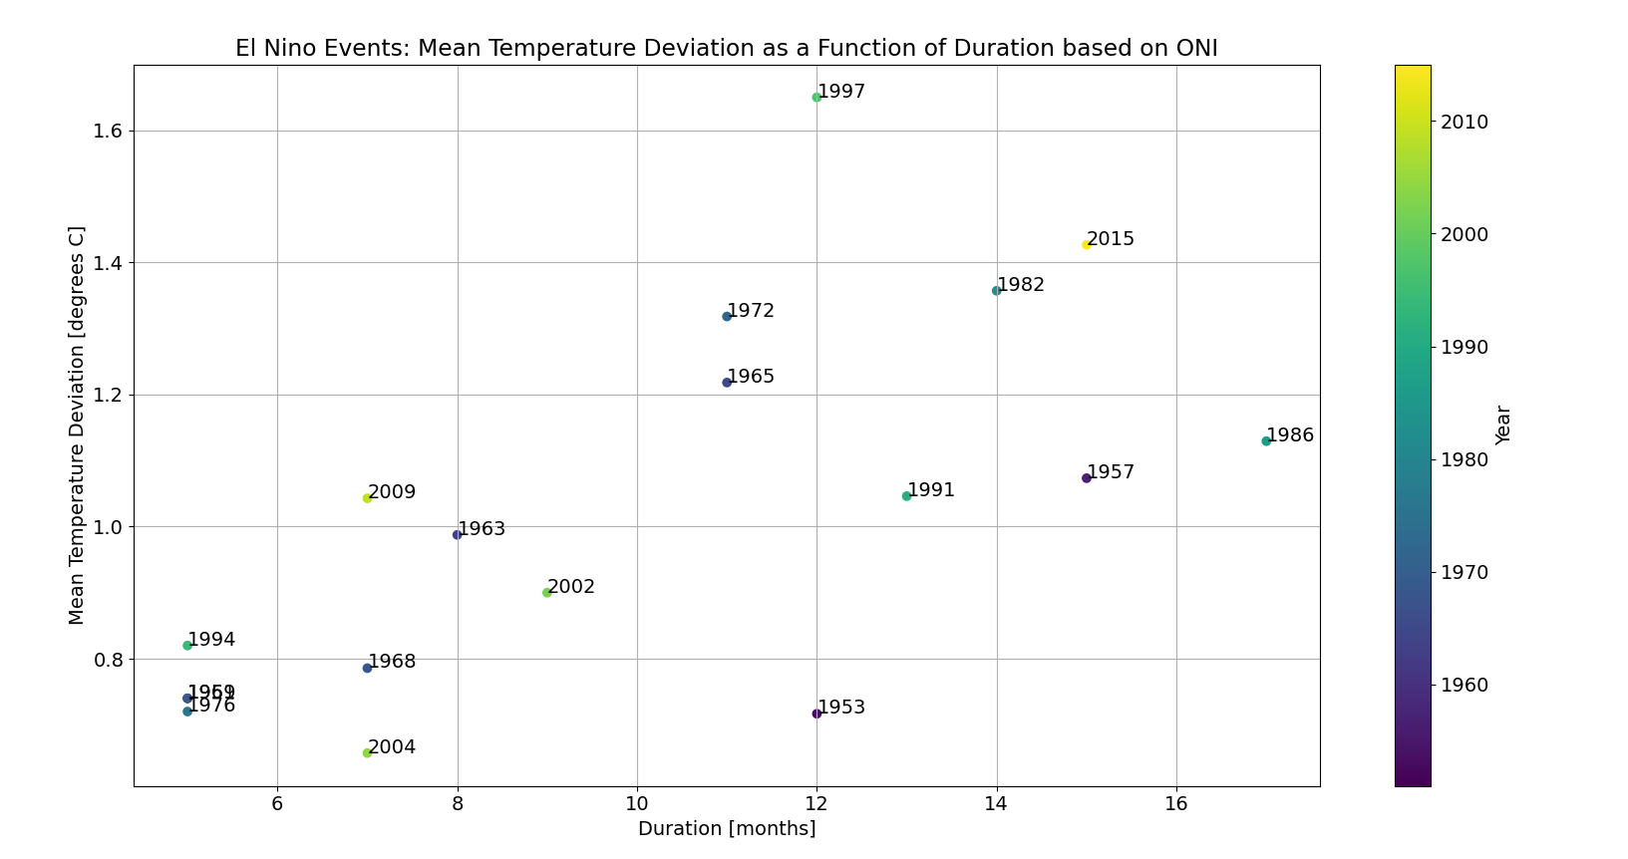

Slide 9
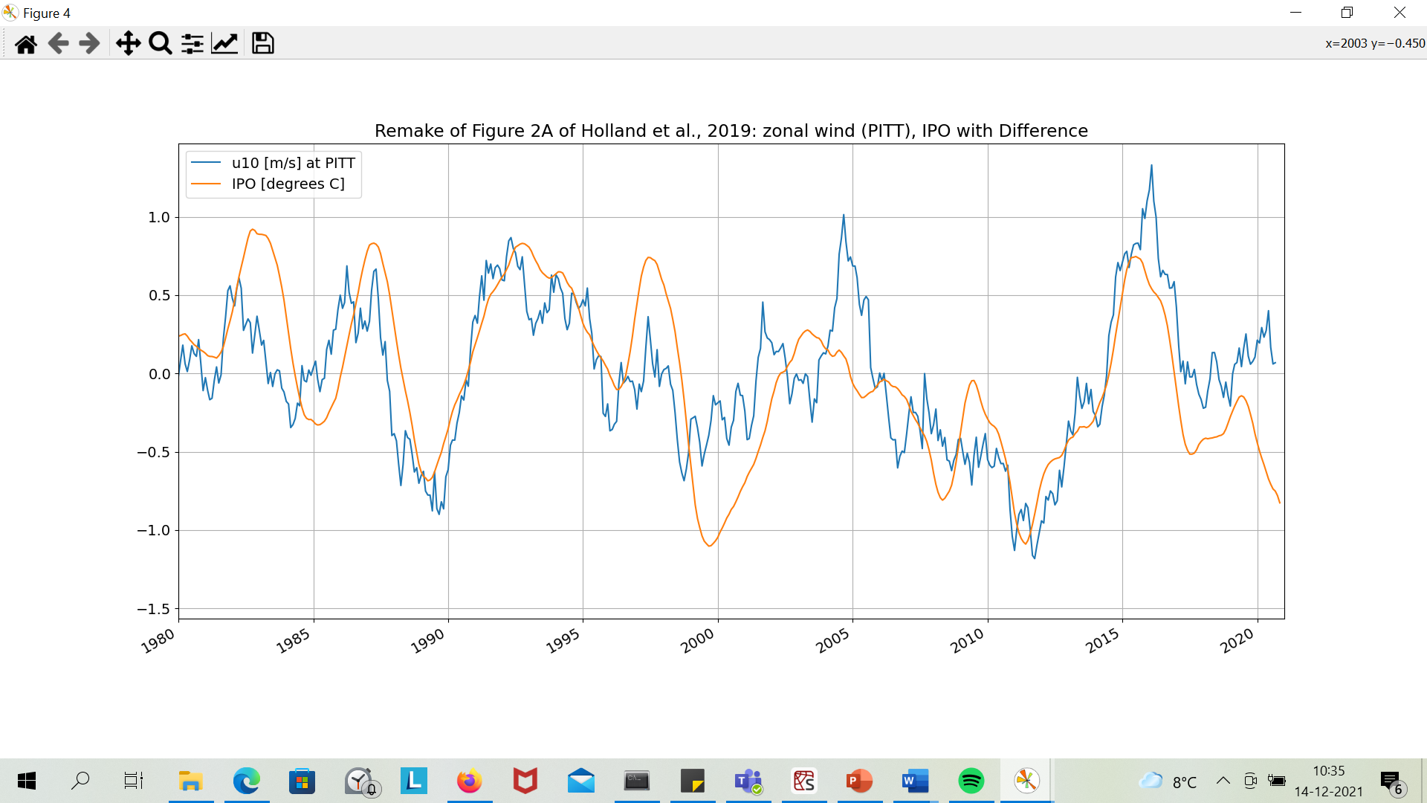

Slide 10
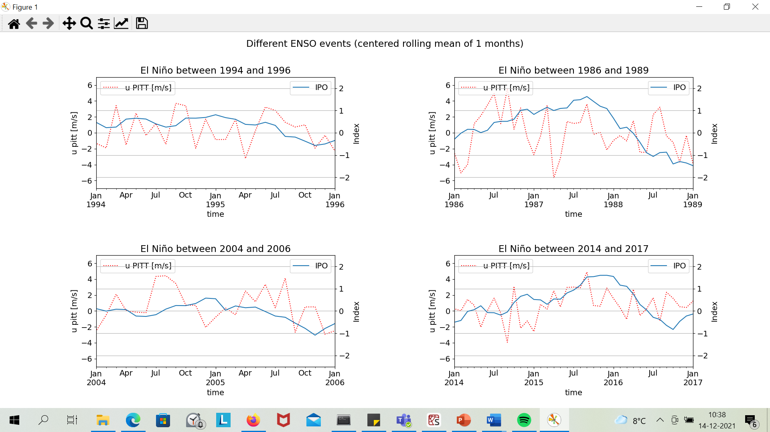
Weak
Strong

Slide 11
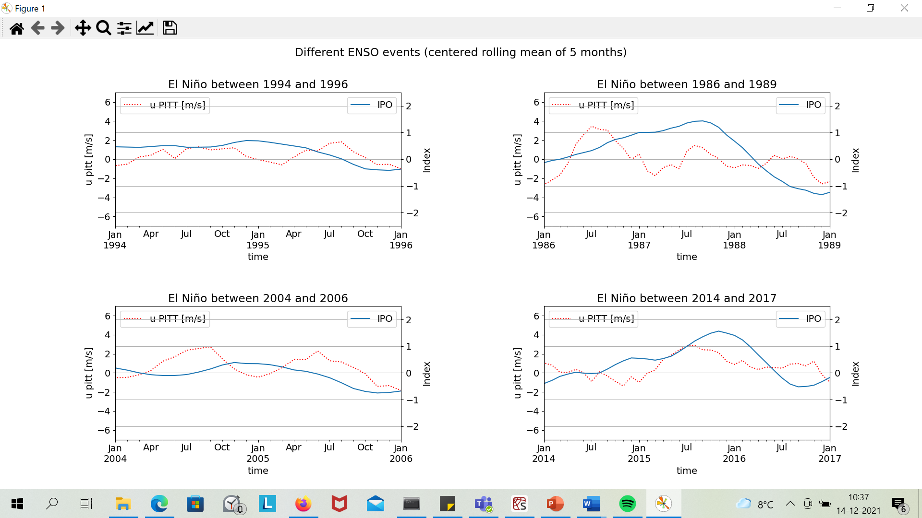
Weak
Strong

Slide 12
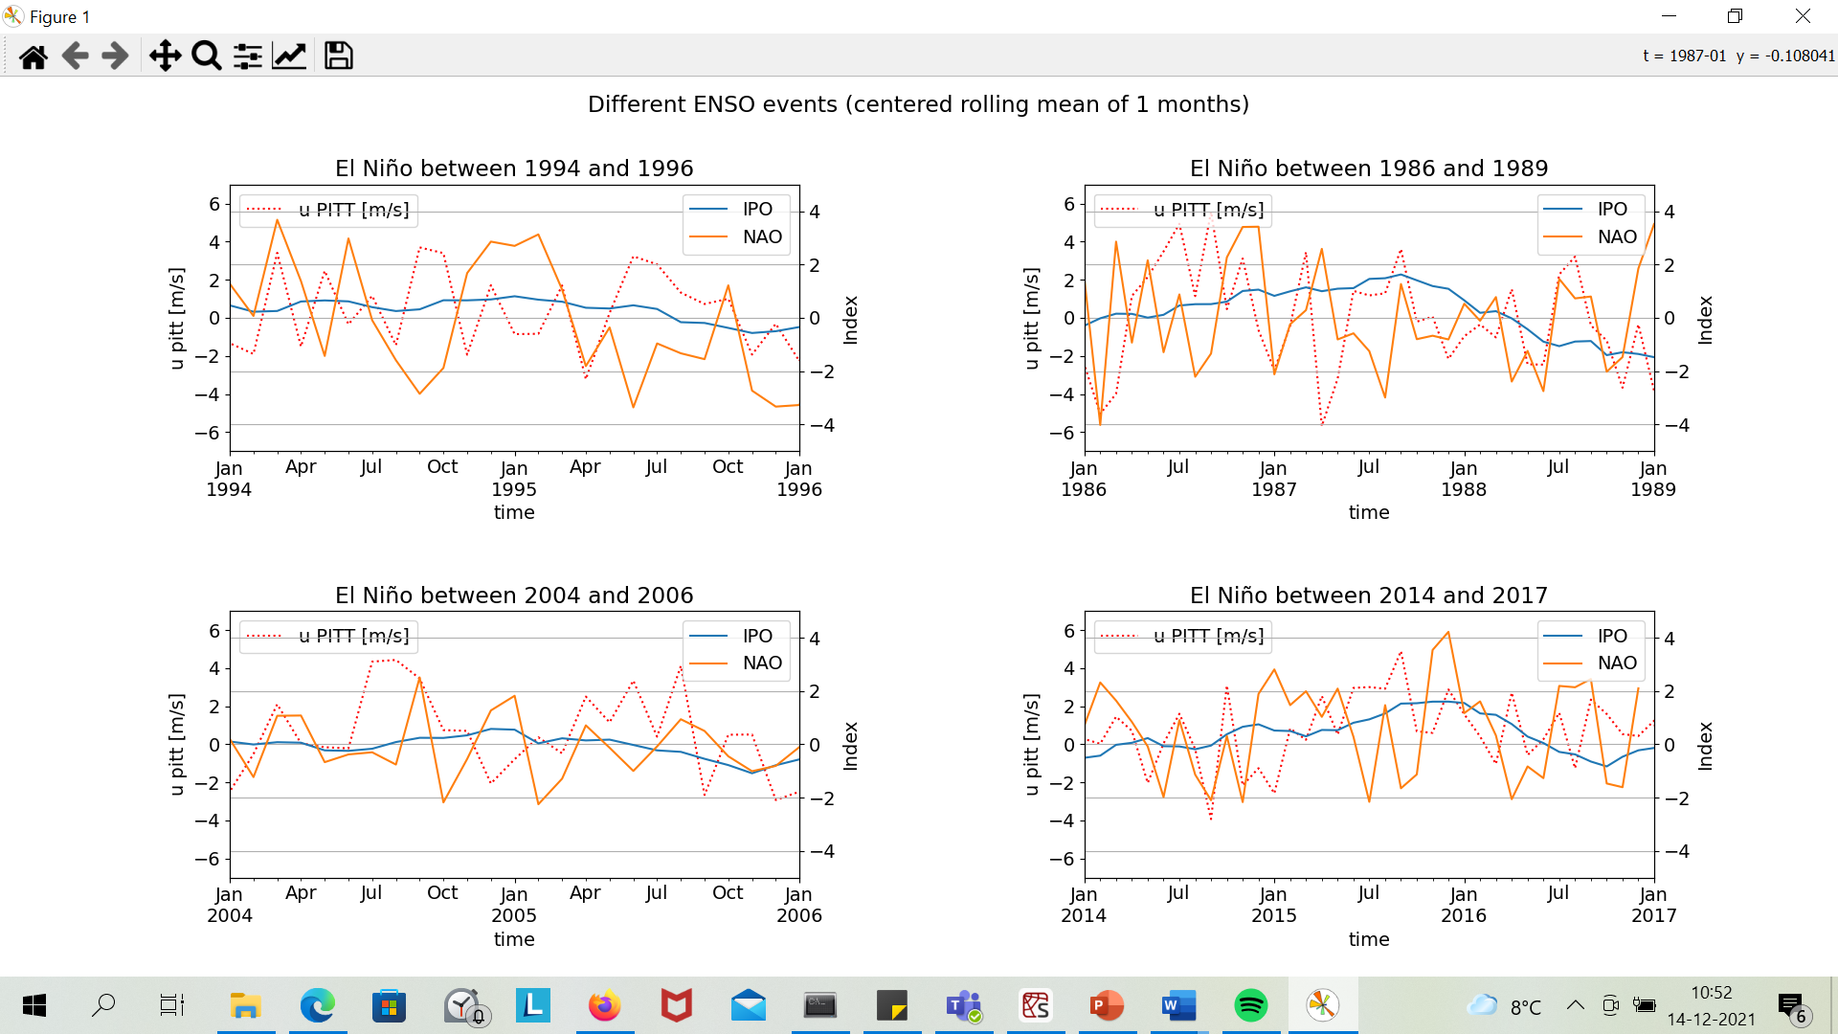

Slide 14
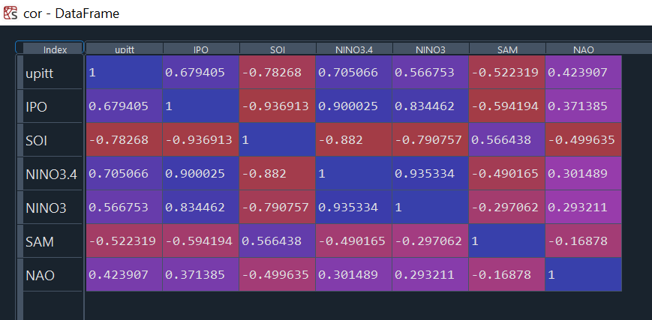
Pearson correlation coefficients for the 24 month rolling mean (as used by Holland et al., 2019)
Mean zonal wind over PITT region

Slide 15
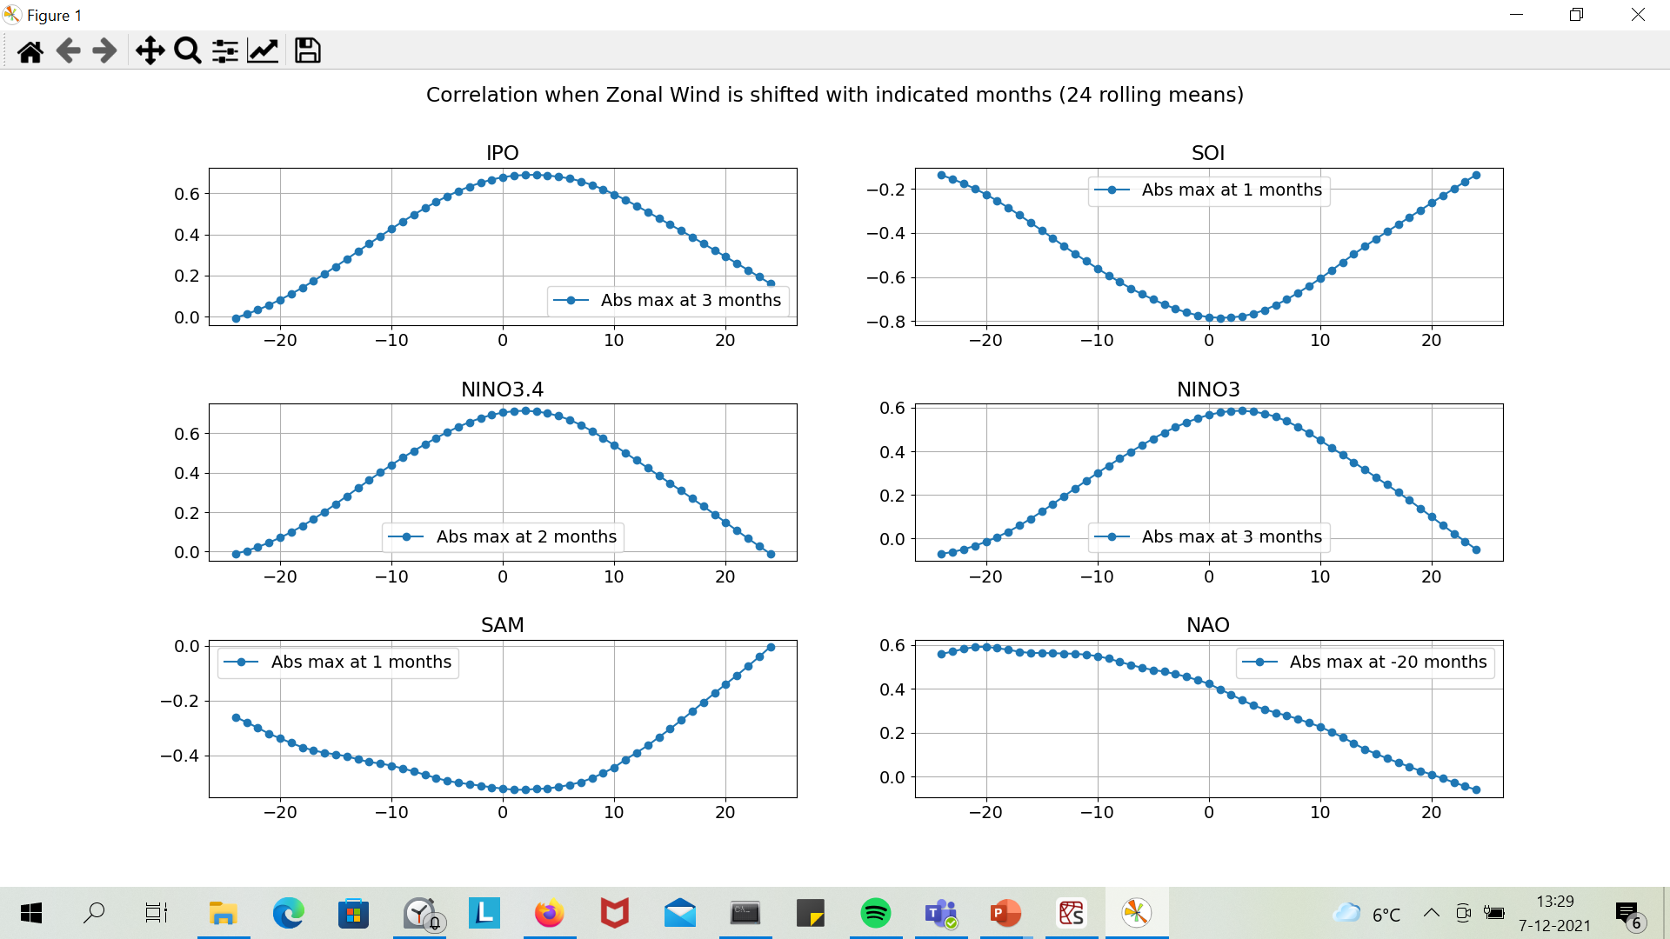
Zonal wind in PITT box, that is.
I guess zonal winds has a lag of +/- 2 months on the Nino indices here.
Interestingly: the NAO index seems to lag strongly behind the winds→ effect of tropical oscillations on NAO?

Slide 16
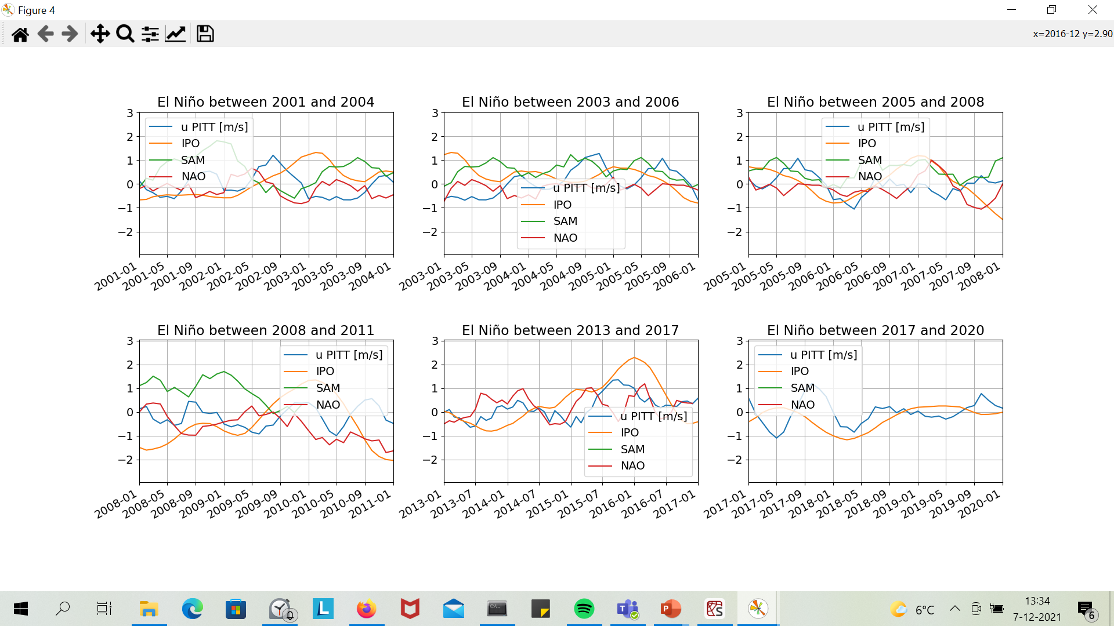
5 month rolling mean→no use ☹

Slide 17
PCA Analysis

Slide 18
Upitt, IPO, NAO, SAM

Slide 19
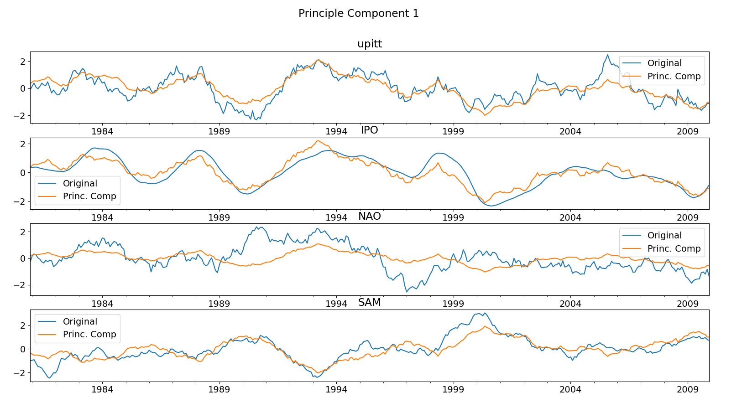

Slide 20
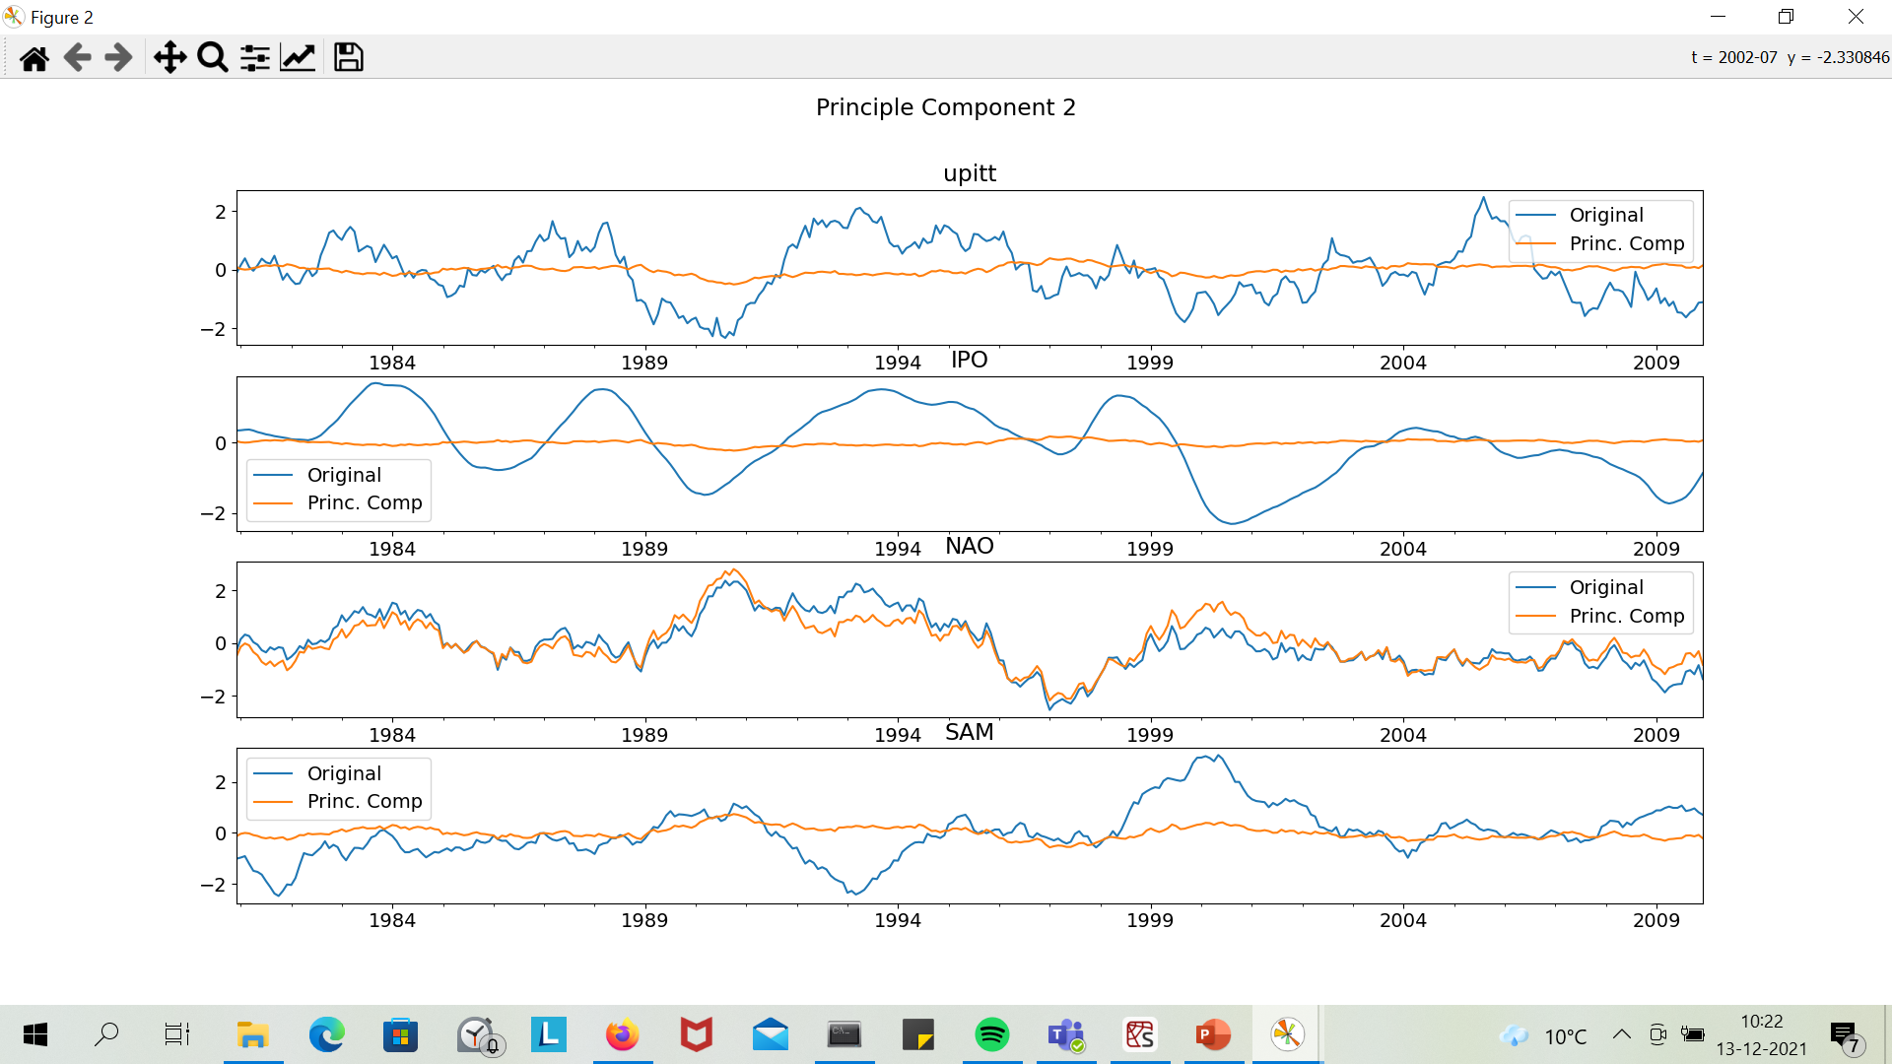

Slide 21
NAO variations usually in second component: little influence?

Slide 22
Upitt, IPO, SAM, AMO

Slide 23
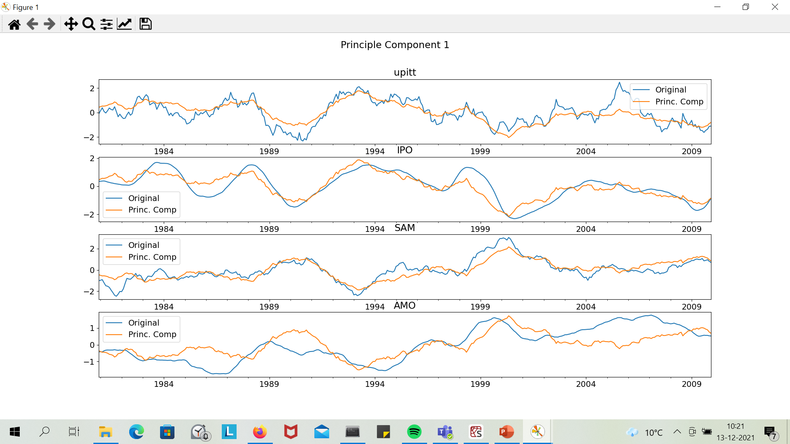

Slide 24
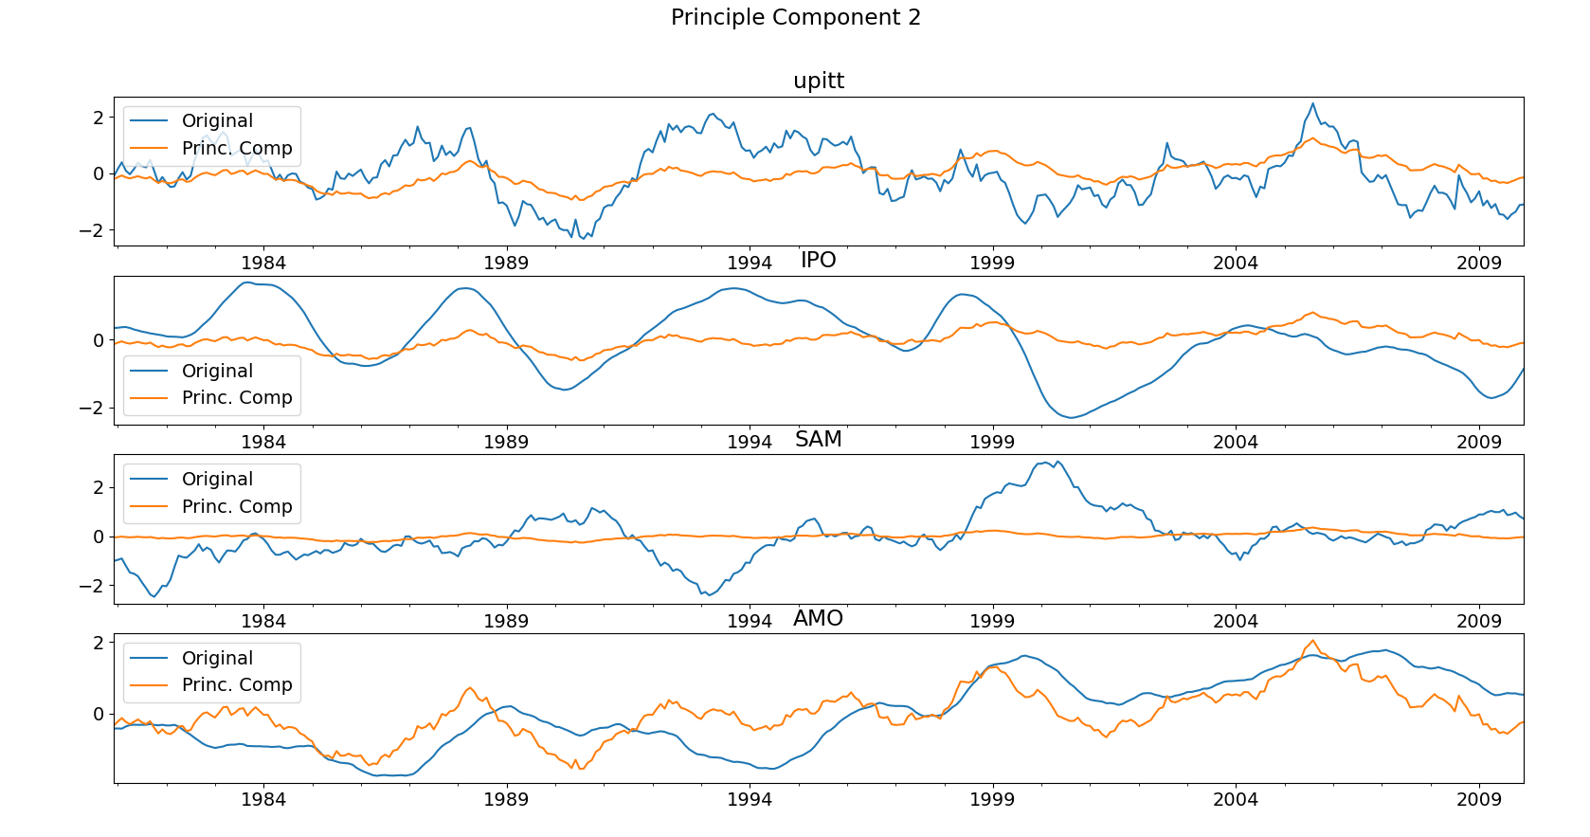

Slide 25
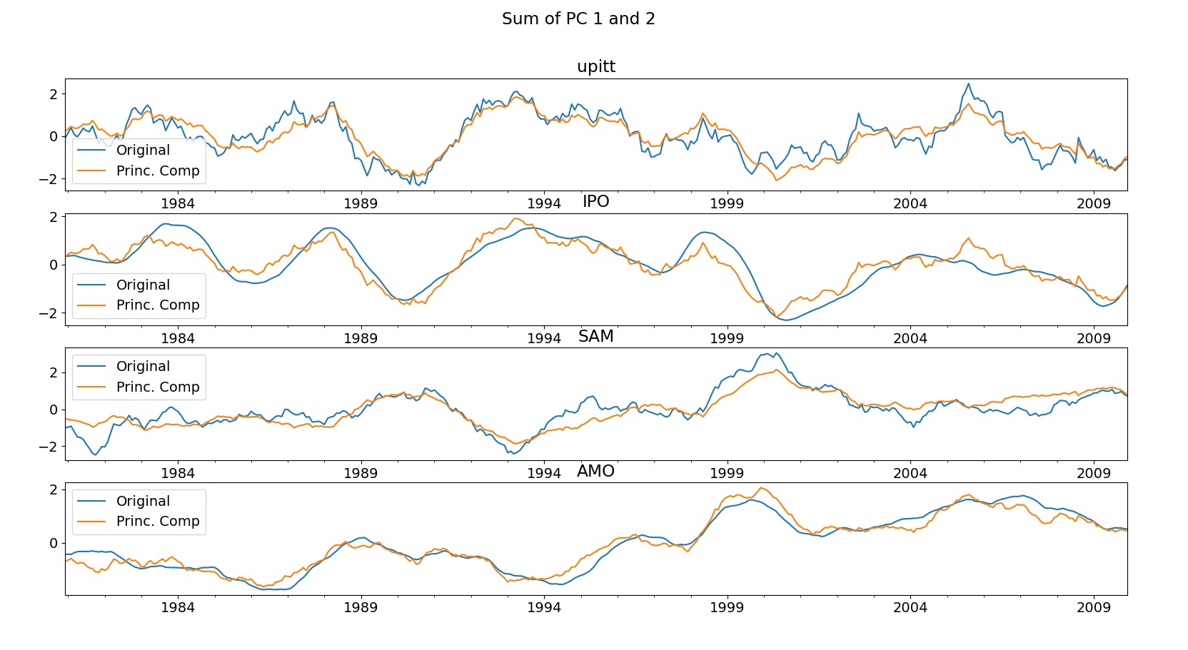

Slide 26
Some influence of AMO? How to interpret?

Slide 27
Spatial Correlation Maps

Slide 28
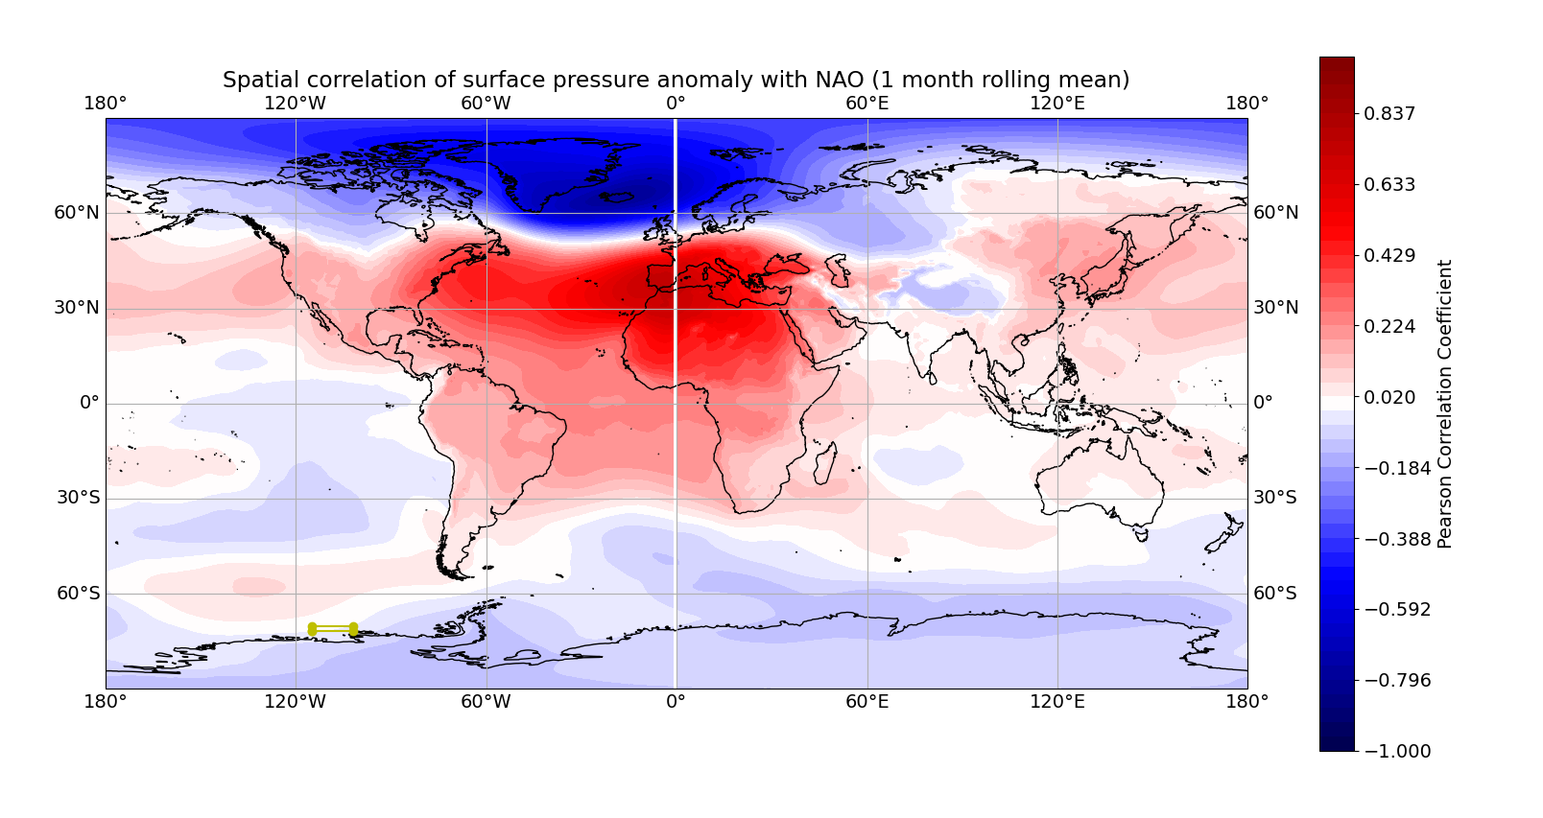
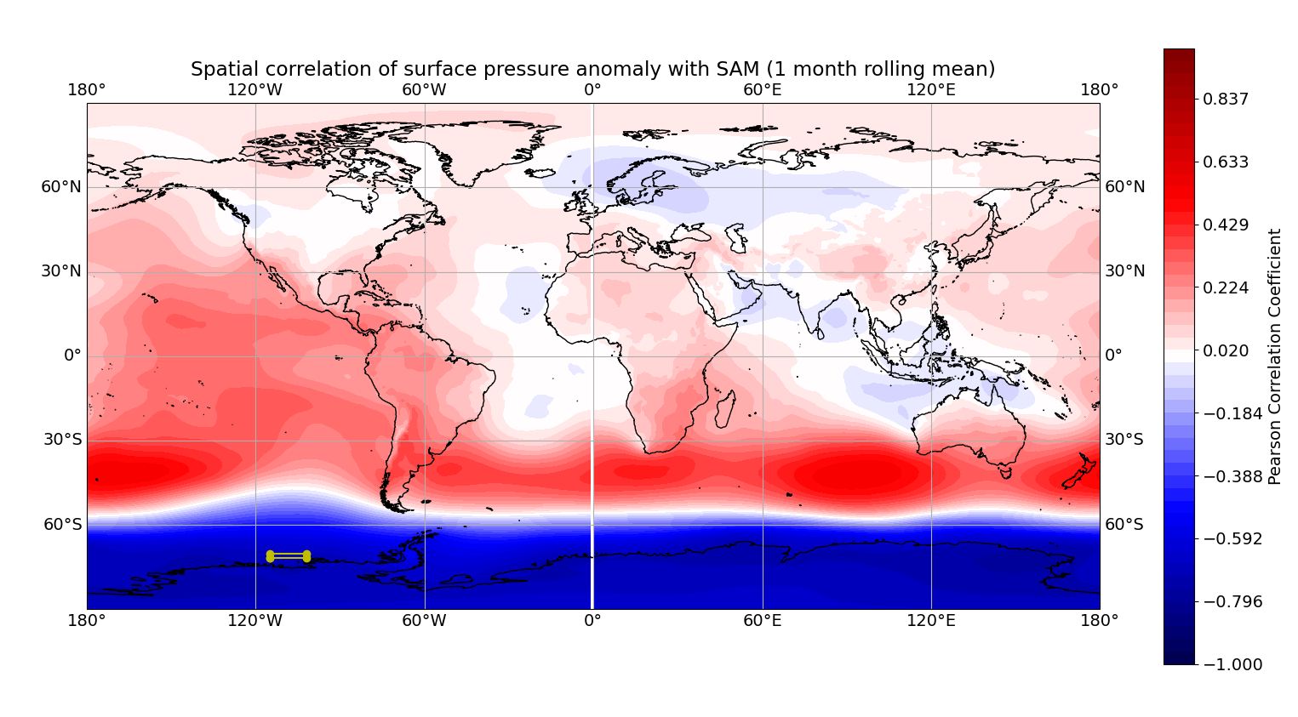
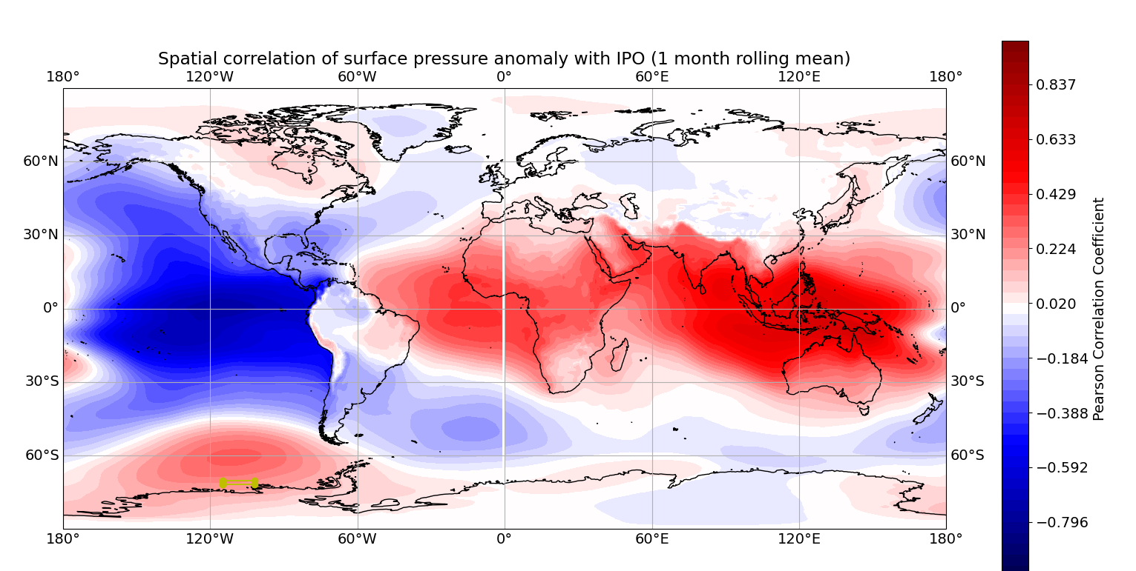
“Benchmark”
Spatial Correlation Maps of the different indices with surface pressure anomalies.
NAO, SAM and IPO.

Slide 29
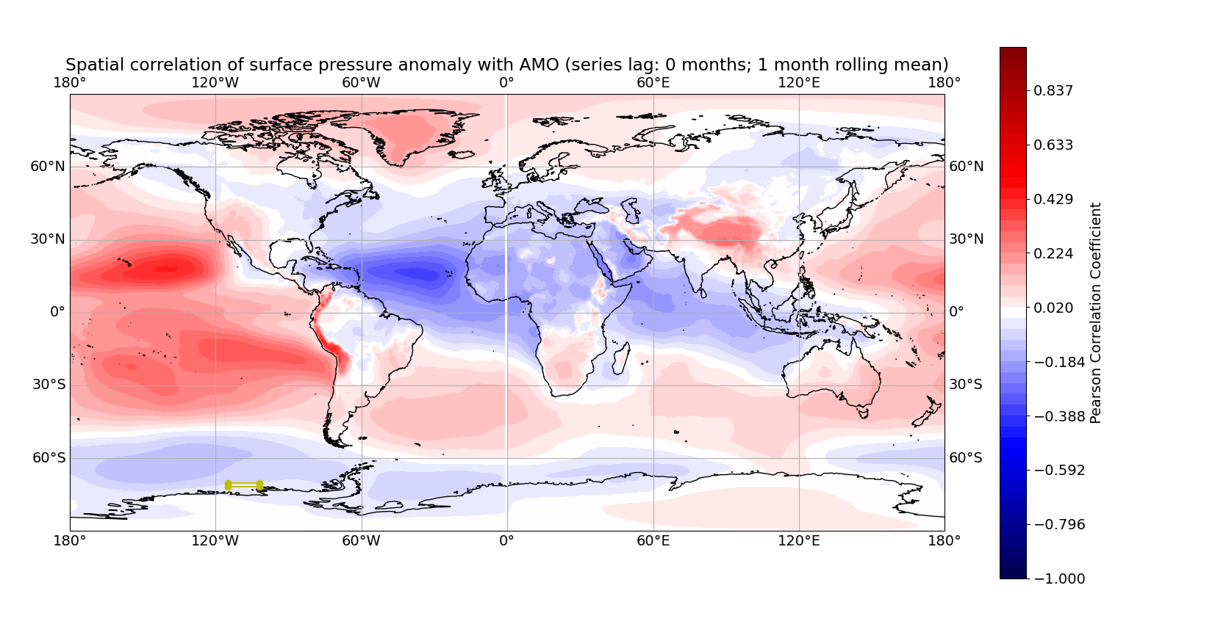

Slide 30
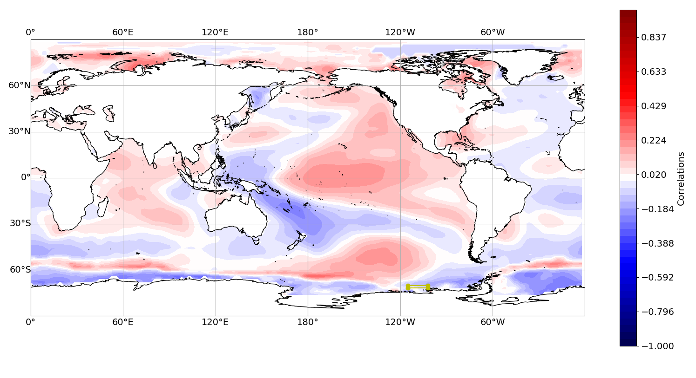
First week: UPITT with SST based on Holland et al., 2019

Slide 31
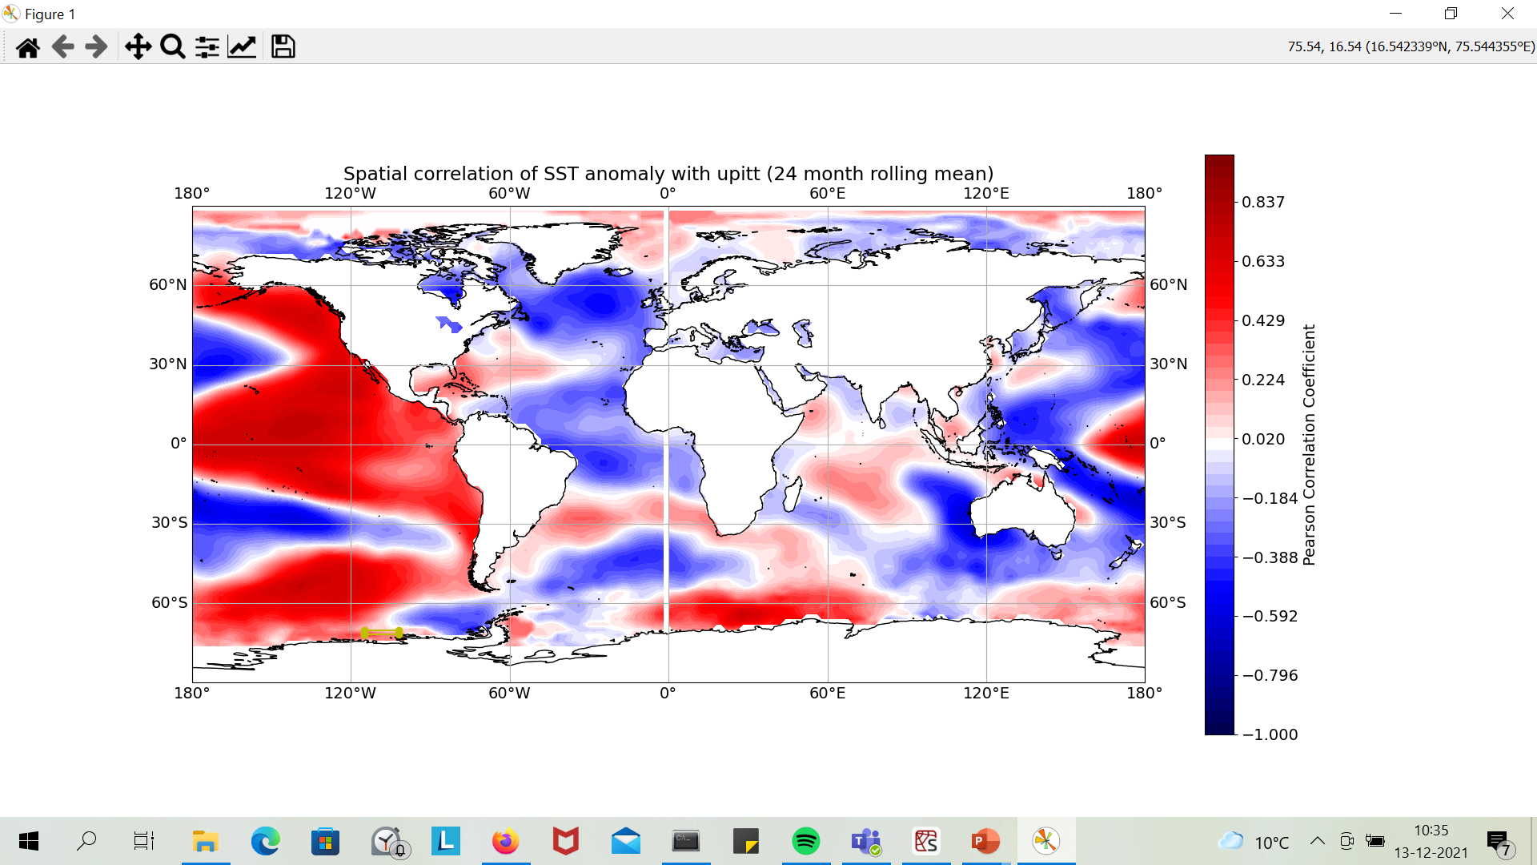

Slide 32
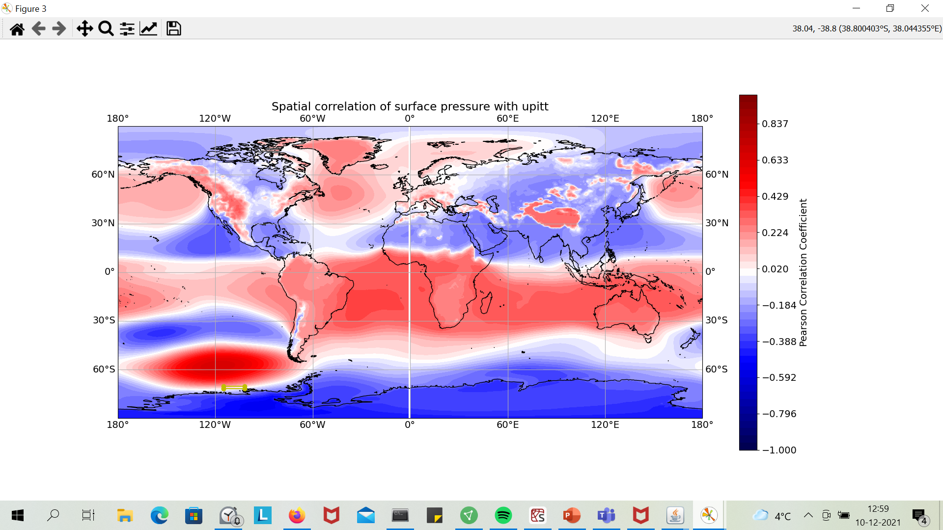

Slide 33
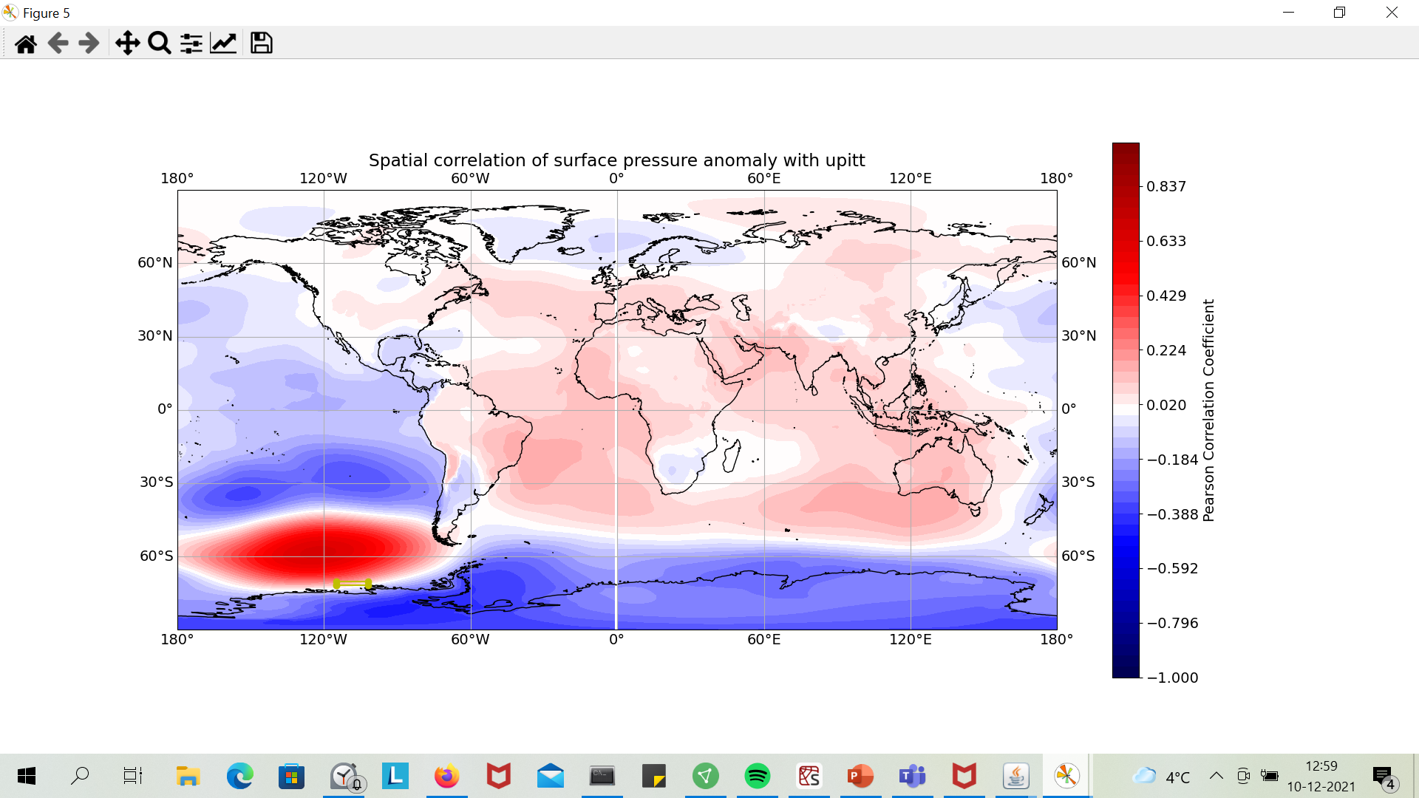

Slide 34
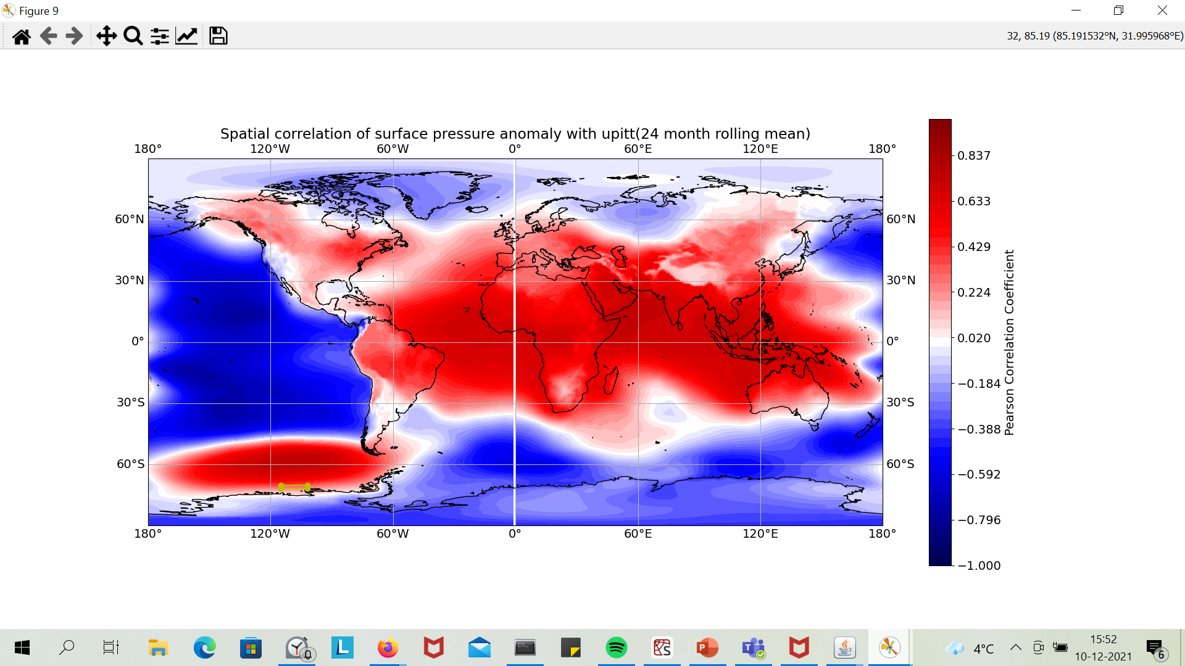

Slide 35
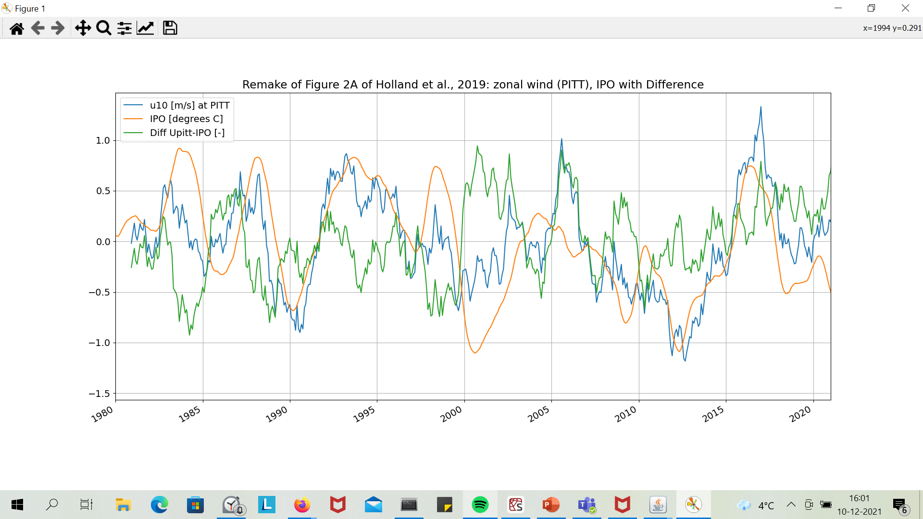

Slide 36
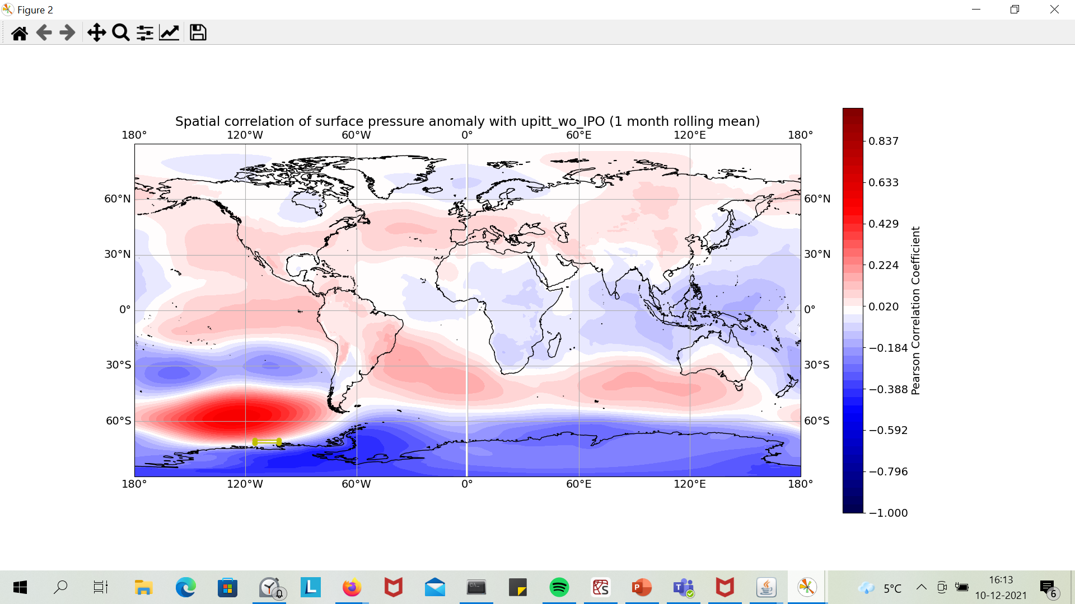
Overcompensation for ENSO?

Slide 37
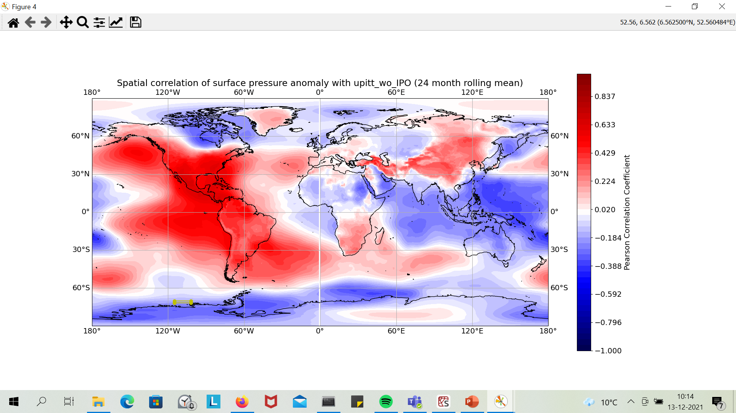
Less influence any more of Amundsen Sea Low?; Some influence of NAO?

Slide 38
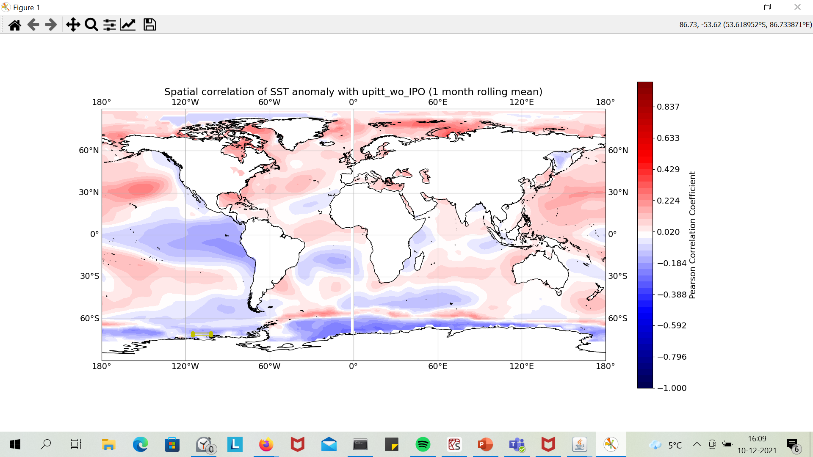

Slide 39
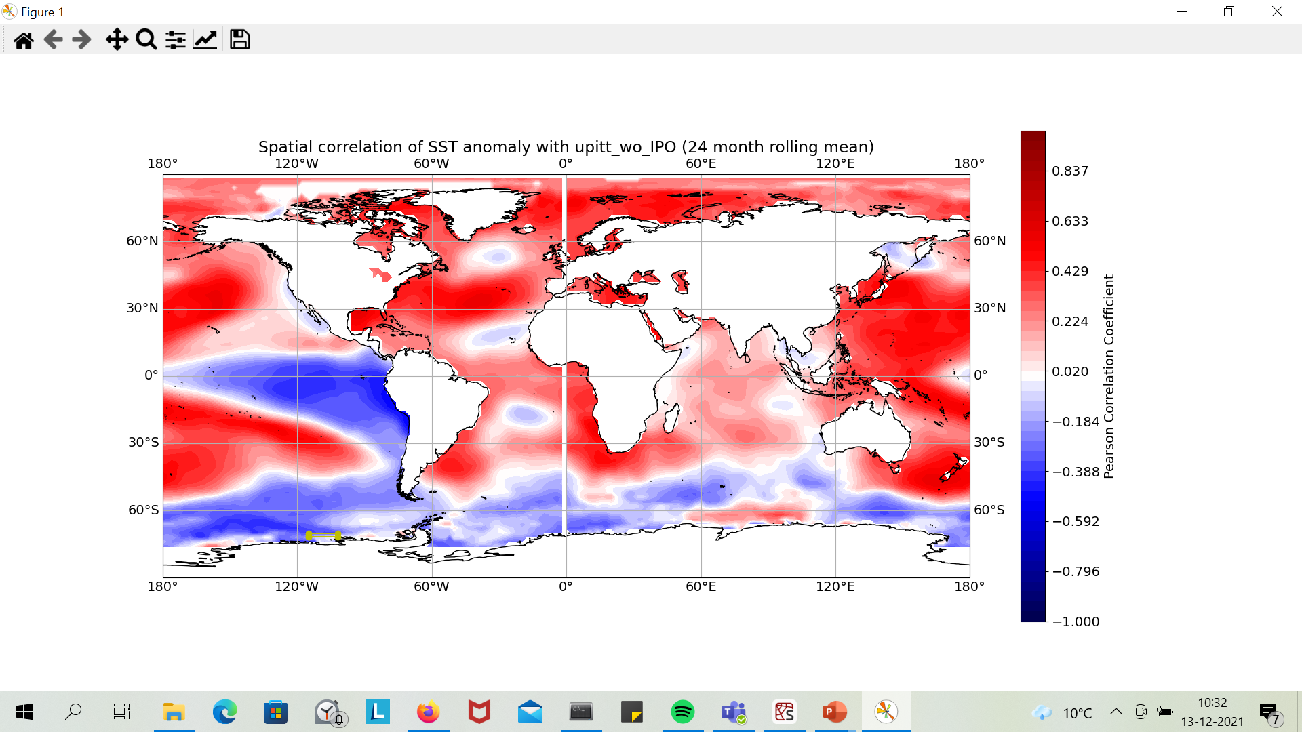

Slide 40
Questions
1940! → better ensemble runs: CESM ensembles (link in document: North Atlantic, Indian Ocean (IOD), etc.), PACE at BAS servers.
Separate ENSO events→ composite ENSO on Amundsen Sea: add them all together → typical time scale, spatial distribution → compare individual events with this (anomalies with respect to this).→ Focus on Amundsen Sea.
What can I do with a spatial PCA? Focus on a separate time series?→AMO
Upitt does not contain all information… How to look at a wider area?→ Paul looks at spatial patterns and sensitivity of the box.
Improving the PCA?
ASL index?→ Tropical influence, Ozone trend (but seasonal dependence!)
Better separation of IPO signal?→ Possibly removing the PCA principal component?→PCA of southern Pacific Basin: pressure, winds, SSTA. Adding patterns together to see motion.→ Look at literature.

Slide 41
To Do?

Slide 43
New goal of Kaitlin (9/12)

